Slide 1




Advanced Tree Structures
Binary Trees, AVL Tree, Red-Black Tree, B-Trees, Heaps
Advanced Tree Structures
SoftUni Team
Technical Trainers
Software University
http://softuni.bg

Slide 2


Table of Contents
Balanced Binary Search Trees
AVL-Tree
Red-Black Tree
AA-Tree
Rope

Slide 3

Balanced Binary Trees
Binary Tree, AA-Tree, AVL-Tree, Rope

Slide 4
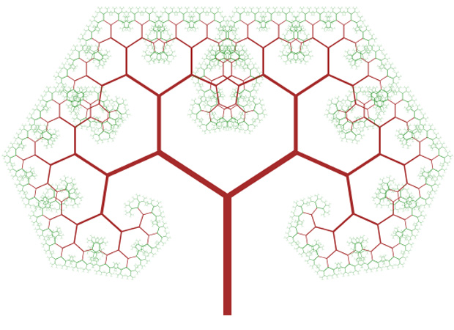
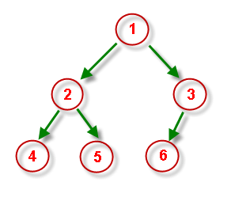
What is Binary Tree?
Binary tree is a tree data structure
Binary tree has a root node
Each node has at most two children
Left and right child
Binary search trees are ordered trees
Binary search trees can be balanced
Subtrees hold nearly equal number of nodes
Subtrees are with nearly the same height

Slide 5
Balanced Binary Search Tree – Example
The left subtree holds 7 nodes
33
The right subtree holds 6 nodes
The left subtree has height of 3
The right subtree has height of 3
18
54
15
24
42
60
3
17
20
29
37
43
85

Slide 6
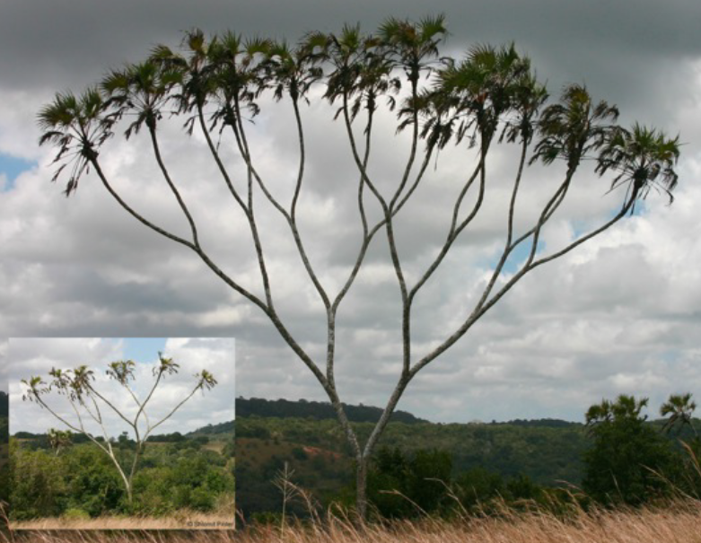
Binary Tree Implementation
Live Demo

Slide 7
Most Popular Binary Trees
Binary tree – tree with at most 2 children
Binary search tree – ordered binary tree
Balanced binary search trees
AA-tree – simple balanced search tree (fast add / find / delete)
AVL-tree – self-balancing binary search tree (very rigidly balanced)
Red-black tree – colored self-balancing binary search tree
Rope – balanced binary tree that preserves the order of elements
Provides fast access by index / add / edit / delete operations
Others – splay tree, treap, top tree, weight-balanced tree, …

Slide 8
AVL Tree
AVL tree is a self-balancing binary-search tree (visualization)
Named after Soviet inventors Adelson-Velskii and Landis
Height of two subtrees can differ by at most 1
17
 | Average | Worst case
Space | O(n) | O(n)
Search | O(log n) | O(log n)
Insert | O(log n) | O(log n)
Delete | O(log n) | O(log n)
9
25
6
12
20

Slide 9
AVL Tree Rebalancing
Balance is preserved with a balance factor (BF) in each node
BF of any node is in the range [-1, 1]
If BF becomes -2 or 2 → rebalance
Rebalancing is done by retracing
Start from inserted node's parent and go up to root
Perform rotations to restore balance
BF == left subtree height – right subtree height
0
-1
17
0
1
2
9
25
0
0
5
12
20
0
1
19

Slide 10
AVL Tree Rotations
Left-Right -> Left-Left Case
1. Left-Right
2. Left-Left
3. Balanced
5
5
4
D
D
3
4
3
5
A
C
A
B
C
D
4
3
B
C
A
B

Slide 11
AVL Tree Rotations
Right-Left -> Right-Right Case
1. Right-Left
2. Right-Right
3. Balanced
3
3
4
A
A
5
4
3
5
D
B
A
B
C
D
4
5
B
C
C
D

Slide 12
AVL Tree – Example
0
0
0
17
17
17
0
1
0
2
0
0
→
→
9
25
9
25
9
22
0
0
0
0
0
0
0
0
0
-1
5
12
20
5
12
19
5
12
19
25
22
0

Slide 13
AVL Tree Insertion Algorithm
Insert node N like in any ordinary BST
Begin retracing from N's parent P up to the root
Modify balance factors as you go up
If balance factor ∉ [-1,1] → rebalance
1
20
0
-1
12
25
0
0
0
8
17
26
0
0
0
0
4
10
15
19

Slide 14
Insertion - #1
Insert 11
1
20
0
-1
12
25
0
0
0
8
17
26
0
0
0
0
4
10
15
19

Slide 15
Insertion - #2
11 < → go left
20
1
20
0
-1
12
25
0
0
0
8
17
26
0
0
0
0
4
10
15
19

Slide 16
Insertion - #3
11 < → go left
12
1
20
0
-1
12
25
0
0
0
8
17
26
0
0
0
0
4
10
15
19

Slide 17
Insertion - #4
11 > → go right
8
1
20
0
-1
12
25
0
0
0
8
17
26
0
0
0
0
4
10
15
19

Slide 18
Insertion - #5
11 > → go right
10
1
20
0
-1
12
25
0
0
0
8
17
26
0
0
0
0
4
10
15
19

Slide 19
Insertion - #6
1
Right node is null → insert
Right subtree grows →reduce 's BF
Did the subtree starting from increase its height?
Yes → begin retracing
No → over
20
10
0
-1
12
25
0
0
0
10
8
17
26
0
-1
0
0
4
10
15
19
0
11

Slide 20
Retracing - #1
1
Node –
Parent –
BF - 1 because right subtree increased height
Go up
10
20
8
0
-1
12
25
-1
0
0
8
17
26
0
-1
0
0
4
10
15
19
0
11

Slide 21
Retracing - #2
1
Node –
Parent –
BF + 1 because left subtree increased height
Go up
8
20
12
1
-1
12
25
-1
0
0
8
17
26
0
-1
0
0
4
10
15
19
0
11

Slide 22
Retracing - #3
2
Node –
Parent –
BF + 1 because left subtree increased height
BF = 2 → rotate
Follow Left Left Case
12
20
20
1
-1
12
25
-1
0
0
8
17
26
0
-1
0
0
4
10
15
19
0
11

Slide 23
Left Left Rotation
2
Node –
Parent –
's right child becomes left child of
becomes right child of
12
20
20
1
-1
12
25
12
-1
0
0
20
8
17
26
20
12
0
-1
0
0
4
10
15
19
0
11

Slide 24
Left Left Rotation #2
0
Invalid Balance factor restored
→ Over
More: https://en.wikipedia.org/wiki/AVL_tree
12
-1
0
8
20
0
-1
0
-1
4
10
17
25
0
0
0
0
11
15
19
26

Slide 25
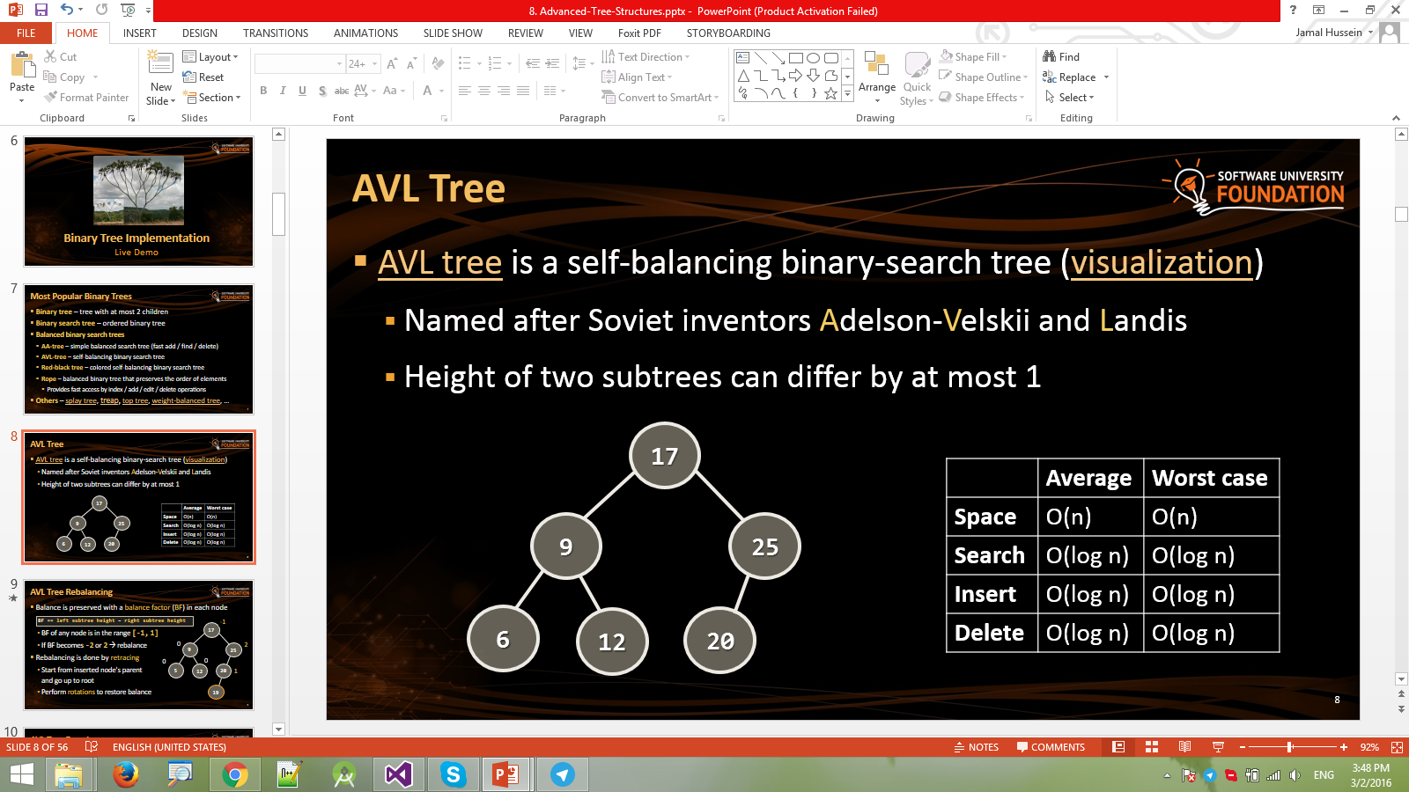
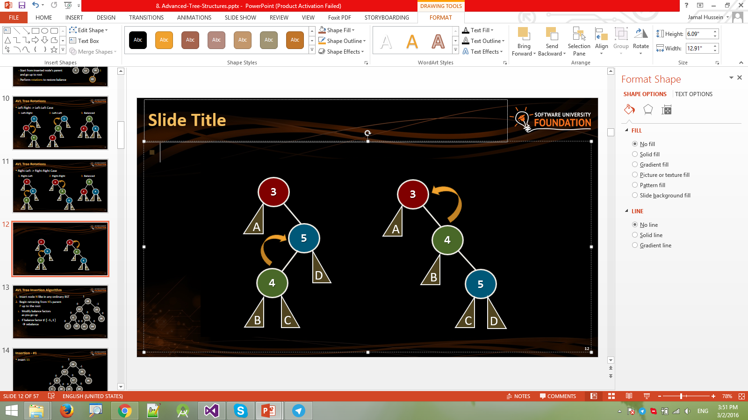
Lab Exercise
AVL Tree Implementation
(Insertion + Search)

Slide 26
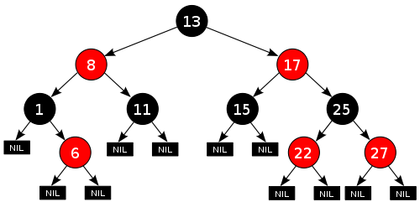
Red-Black Tree
Red-Black tree – binary search tree with red and black nodes
Not perfectly balanced, but has height of O(log n)
Used in C# and Java
See the visualization
AVL vs. Red-Black
AVL has faster search (it is better balanced)
Red-Black has faster insert / delete
Red-Black tree proof

Slide 27
Red-Black Tree Properties
13
A node is either red or black
The root is black
All leaves ( ) are black
If a node is red, then both its children are black
Every path from a given node to its descendant leaf nodes contains the same number of black nodes
E.g. All paths from have exactly 1 black node
8
17
1
11
15
25
NIL
NIL
6
NIL
NIL
NIL
NIL
22
27
NIL
NIL
NIL
NIL
NIL
NIL
13

Slide 28

Red-Black Tree Implementation
red
black
Live Demo

Slide 29
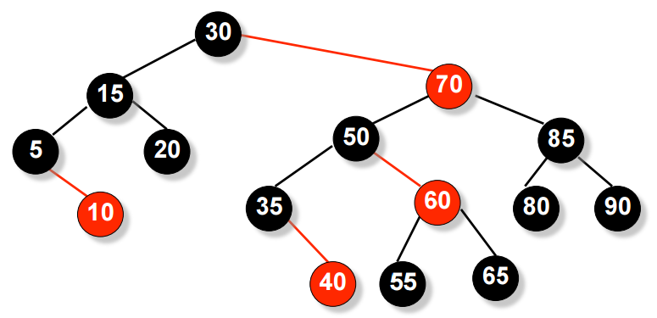
AA Tree
AA tree (Arne Andersson)
Simple self-balancing binary-search tree
Simplified Red-Black tree
Easier to implement than AVL and Red-Black
Some Red-Black rotations are not needed
Slower than AVL & RB

Slide 30
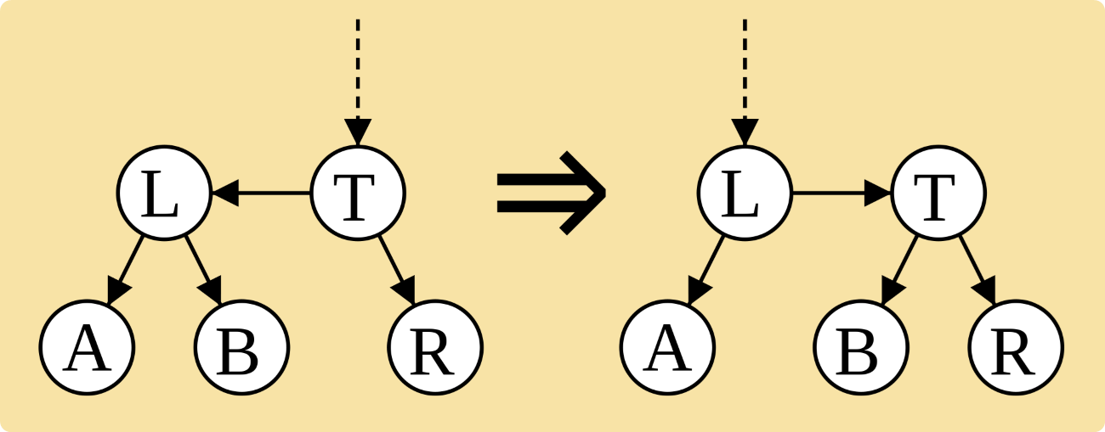
AA Tree Implementation
Live Demo

Slide 31
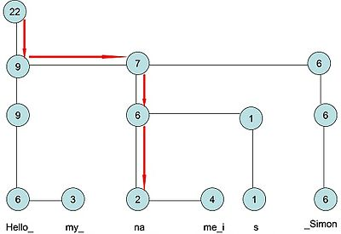


Rope
Rope == balanced tree for indexed items with fast insert / delete
Allows fast string edit operations on very long strings
Rope is a binary tree having leaf nodes
Each node holds a short string
Each node has a weight value equal to length of its string

Slide 32
Ropes in Practice: When to Use Rope?
Ropes are efficient for very large strings
E.g. length > 10 000 000
For small strings ropes are slower!
List<T> and StringBuilder performs better for 100 000 chars
Ropes provide:
Faster insert / delete operations at random position – O(log(n))
Slower access by index position – O(log(n))
Arrays provide O(1) access by index

Slide 33


Rope (Wintellect BigList<T>)
Live Demo

Slide 34

Summary
Balanced binary search trees provide fast add / search / remove operations – O(log n)
AVL trees are rigidly balanced BSTs
Fast search, slower add/remove
Red-Black trees are less balanced → slower search time
Provide faster add/remove
Ropes are used for manipulation of very long strings
Provide fast insertion/deletion – O(log n)

Slide 35








Advanced Tree Structures
https://softuni.bg/trainings/1308/data-structures-february-2016

Slide 36
License
This course (slides, examples, labs, videos, homework, etc.) is licensed under the "Creative Commons Attribution-NonCommercial-ShareAlike 4.0 International" license
Attribution: this work may contain portions from
"Fundamentals of Computer Programming with C#" book by Svetlin Nakov & Co. under CC-BY-SA license
"Data Structures and Algorithms" course by Telerik Academy under CC-BY-NC-SA license

Slide 37






Free Trainings @ Software University
Software University Foundation – softuni.org
Software University – High-Quality Education, Profession and Job for Software Developers
softuni.bg
Software University @ Facebook
facebook.com/SoftwareUniversity
Software University @ YouTube
youtube.com/SoftwareUniversity
Software University Forums – forum.softuni.bg

